Slide 1

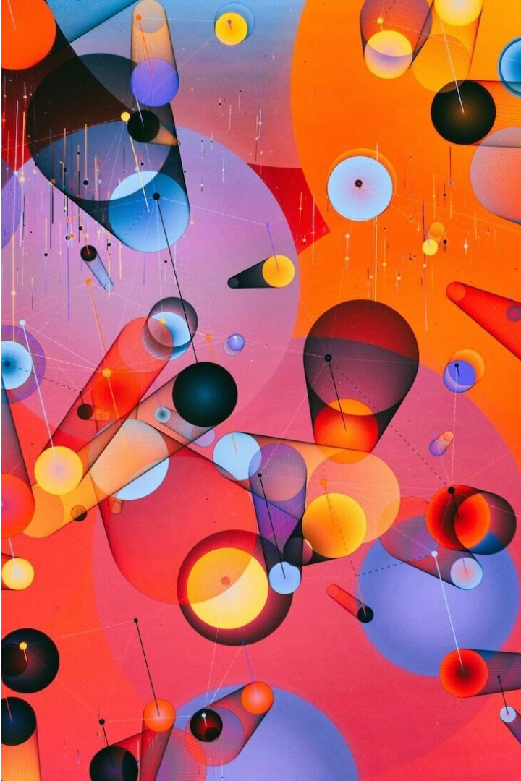


Introduction to Generative Models
Generative models are a powerful class of machine learning algorithms that can learn to generate new data, such as images, text, or molecular structures, by capturing the underlying patterns and distributions in existing data. These models hold immense potential for transforming drug discovery by automating the design of novel and effective therapeutic compounds.
by P.vinoth Kumar

Slide 2

Challenges in Molecular Design
Complex chemical space: The vast number of possible drug-like molecules poses a significant challenge in exploring and identifying promising candidates.
Balancing desired properties: Optimizing multiple, often conflicting, properties such as potency, selectivity, solubility, and toxicity is a delicate and nuanced process.
Limited data availability: Experimental data on molecular properties and biological activities is often sparse, making it difficult to train robust predictive models.

Slide 3
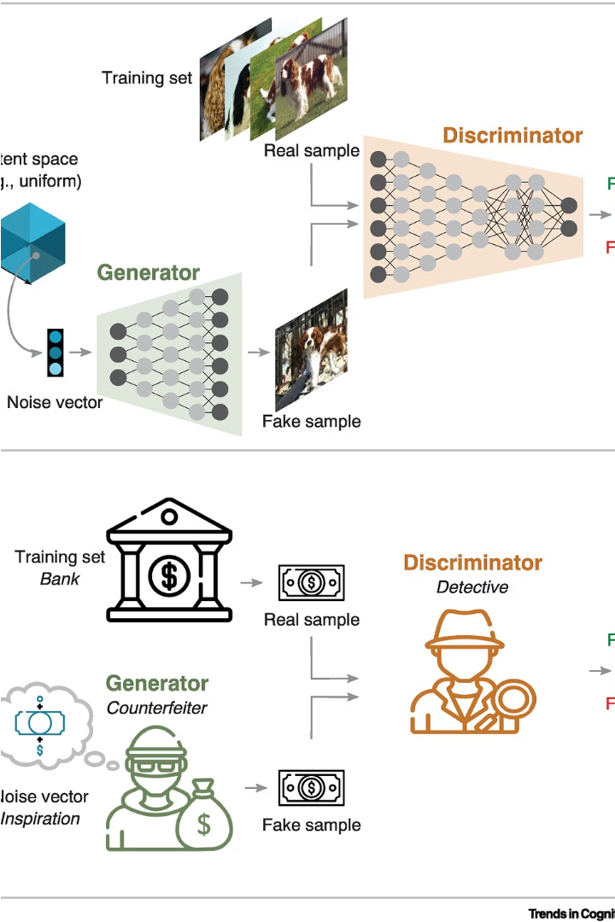
Generative Adversarial Networks (GANs)
Generative Adversarial Networks (GANs) are a powerful class of generative models that employ an adversarial training process. A GAN consists of two neural networks - a generator and a discriminator - that compete against each other to create realistic, novel molecular structures.

Slide 4
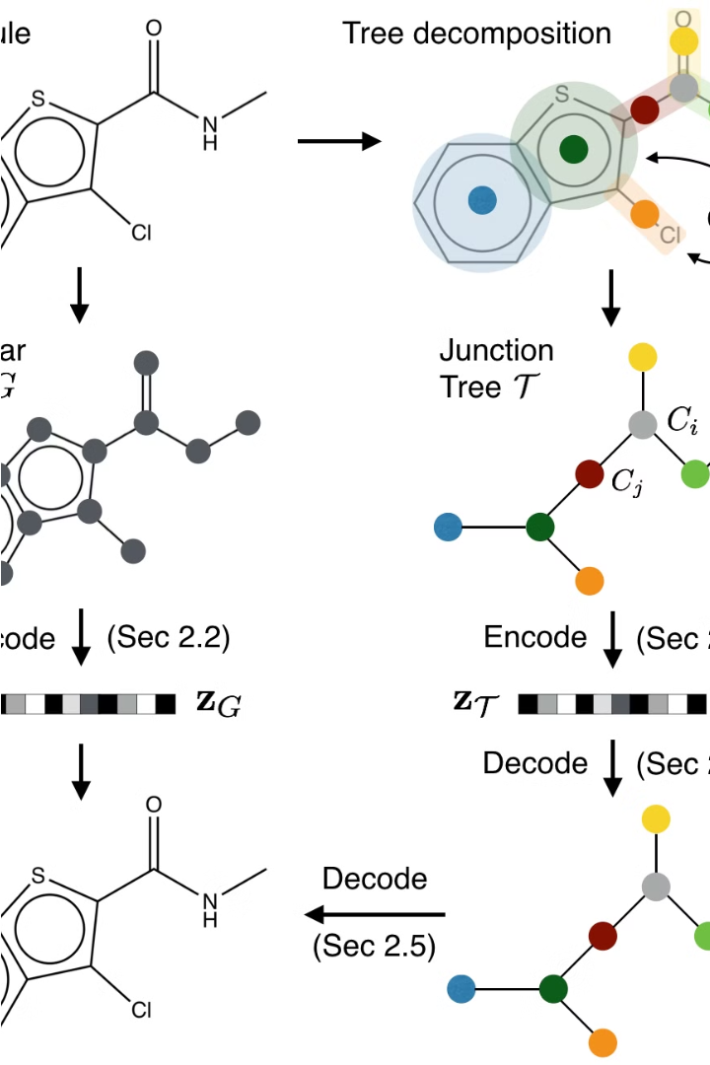
Variational Autoencoders (VAEs)
Variational Autoencoders (VAEs) are another powerful class of generative models that learn to encode data into a compact latent representation, which can then be used to generate novel and diverse molecular structures. VAEs leverage a probabilistic approach to capture the underlying data distribution and enable efficient sampling of new molecules.

Slide 5

Reinforcement Learning Approaches
1
Reward Shaping
Designing effective reward functions to guide the model towards desired molecular properties and drug-like characteristics.
2
Adversarial Reinforcement
Combining reinforcement learning with adversarial training to promote the generation of diverse, high-quality molecular structures.
3
Hierarchical RL
Using a hierarchical approach to break down the molecular design task into subtasks, enabling more efficient exploration of the chemical space.

Slide 6
Molecular Representations and Fingerprints
Molecular Graphs
SMILES Strings
Molecular Fingerprints
3D Conformations
Molecules can be represented as graphs, where atoms are nodes and bonds are edges. This graph-based encoding captures the connectivity and topology of the molecular structure.
SMILES (Simplified Molecular Input Line Entry System) is a text-based representation of molecular structures, providing a compact and versatile way to encode and share chemical information.
Fingerprints are high-dimensional binary vectors that encode the structural features of a molecule, enabling efficient similarity comparisons and database searches.
Incorporating the three-dimensional spatial arrangement of atoms is crucial for accurately modeling molecular interactions and predicting biological activities.

Slide 7
Evaluation Metrics for Generative Models
Validity: Ensuring the generated molecules are chemically valid and can be synthesized in a laboratory setting.
Diversity: Measuring the variety and novelty of the generated molecular structures compared to existing compounds.
Relevance: Evaluating the drug-likeness and potential biological activities of the generated molecules using computational and experimental assays.
Optimality: Quantifying the optimization of multiple, often conflicting, molecular properties such as potency, selectivity, solubility, and toxicity.

Slide 8
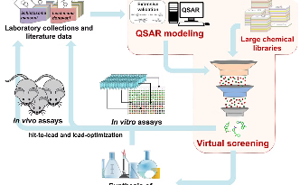
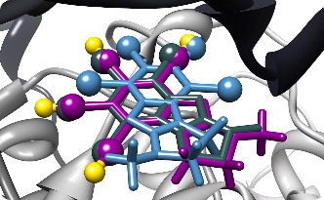

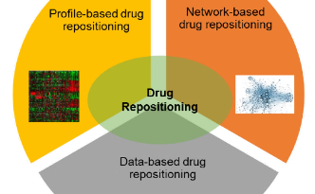
Applications in Drug Discovery
High-Throughput Screening
Molecular Optimization
De Novo Design
Drug Repurposing
These models can iteratively refine and improve the properties of lead compounds, guiding medicinal chemists towards more potent, selective, and drug-like molecules.
Generative models can create novel, entirely new molecular structures that meet the desired criteria for drug-likeness, opening up unexplored regions of the chemical space.
Generative models can be leveraged to identify new potential uses for existing drugs, accelerating the drug development process and reducing costs.
Generative models can accelerate the screening of millions of virtual compounds to identify promising drug candidates for further development and optimization.

Slide 9
Case Studies and Success Stories
Generative Adversarial Networks for Novel Compounds
Variational Autoencoders for Optimizing Drug Candidates
A VAE-powered platform enabled lead optimization, enhancing the drug-likeness and pharmacokinetic profiles of candidate molecules for a rare disease target.
Researchers used a GAN-based model to generate previously undiscovered molecules with potent anticancer properties, leading to promising preclinical results.
Reinforcement Learning for Targeted Molecular Design
Generative Models for Drug Repurposing
By incorporating reinforcement learning, scientists designed novel small molecules that selectively bind to a challenging protein target involved in inflammation.
Generative models identified new potential uses for an existing drug, leading to a successful phase II clinical trial for a rare neurological disorder.

Slide 10
Future Directions and Opportunities
Exploring Uncharted Chemical Space
Hybrid Modeling Approaches
Integrating generative models with other computational techniques, such as quantum chemistry and molecular dynamics simulations, can enhance the accuracy and reliability of virtual drug screening.
Generative models can unlock the vast, unexplored regions of the chemical universe, leading to the discovery of unprecedented molecular structures with unprecedented therapeutic potential.
Interpretable and Explainable AI
Incorporation of Experimental Data
Developing generative models that provide transparent, interpretable insights into the underlying design principles can accelerate the translation of computational discoveries into successful drug candidates.
Leveraging the growing wealth of experimental data on molecular properties and biological activities can further improve the performance and robustness of generative models for drug discovery.

